Slide 1

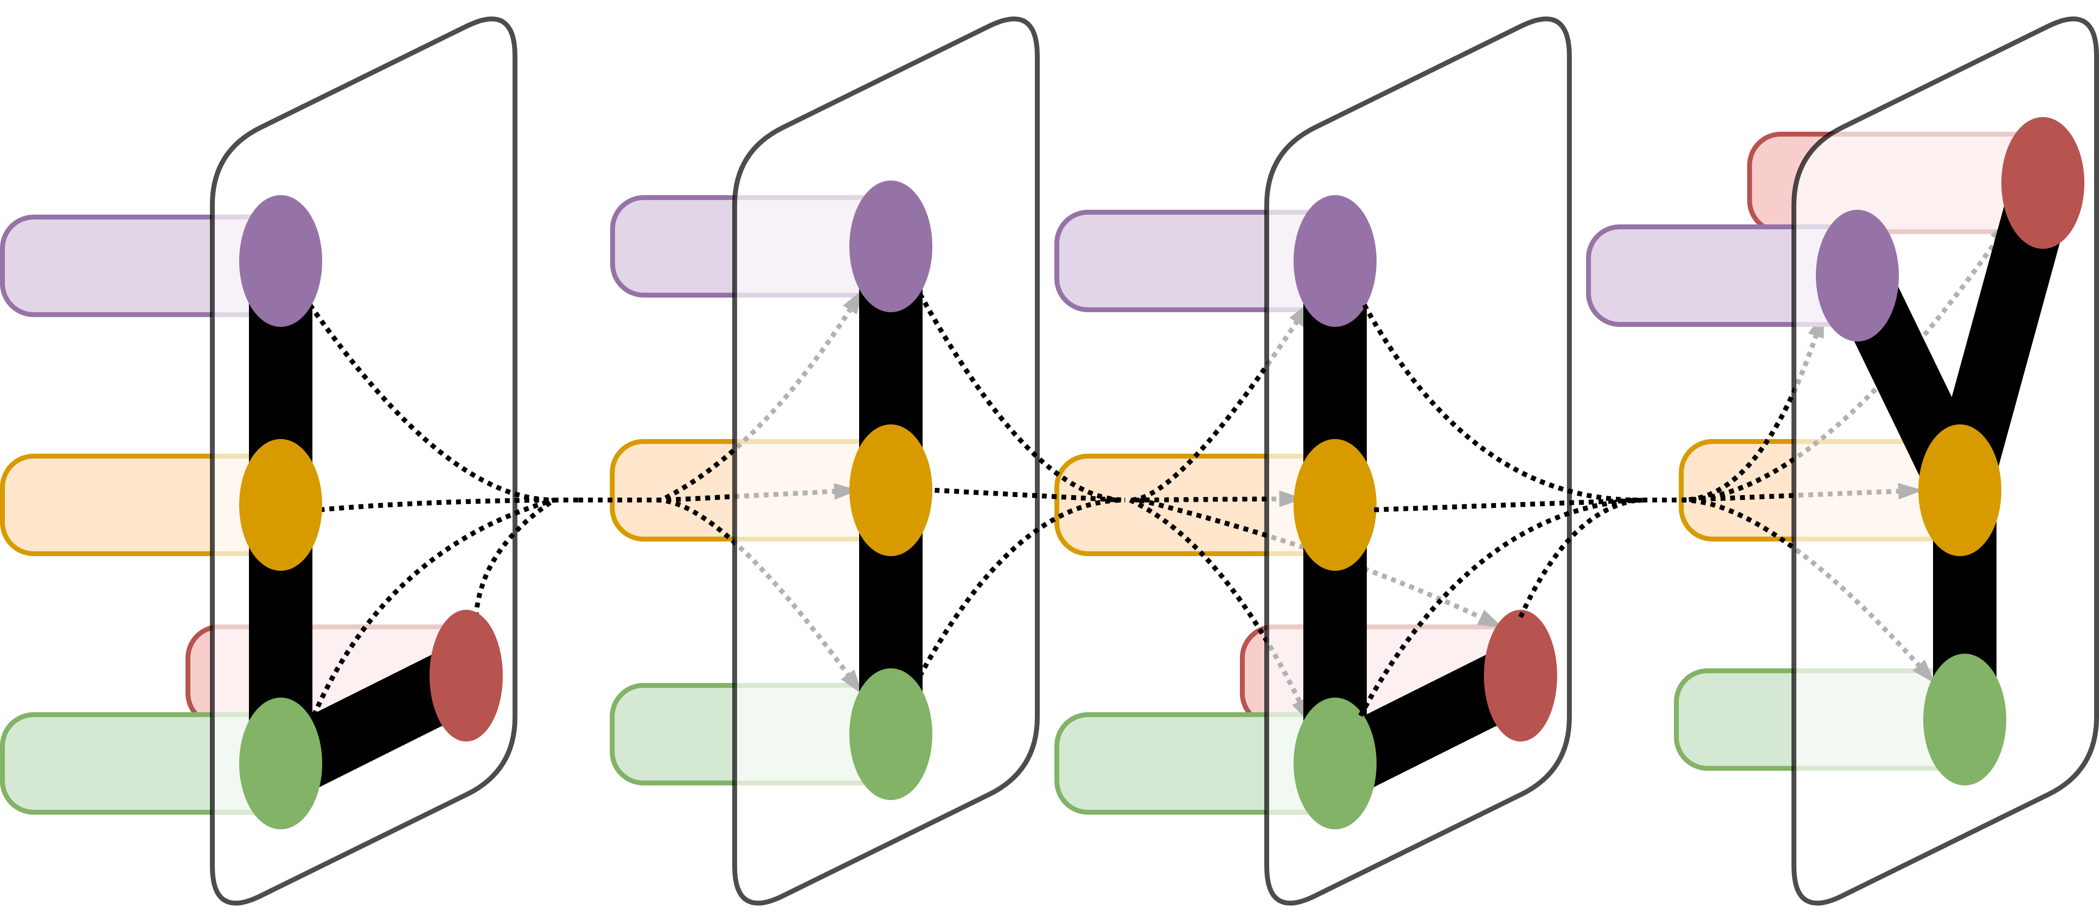
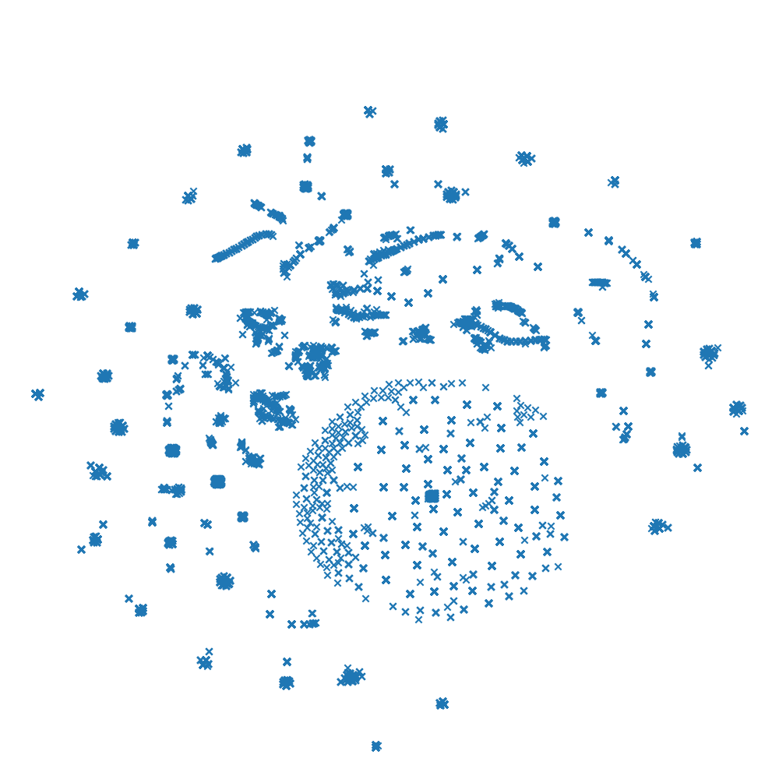
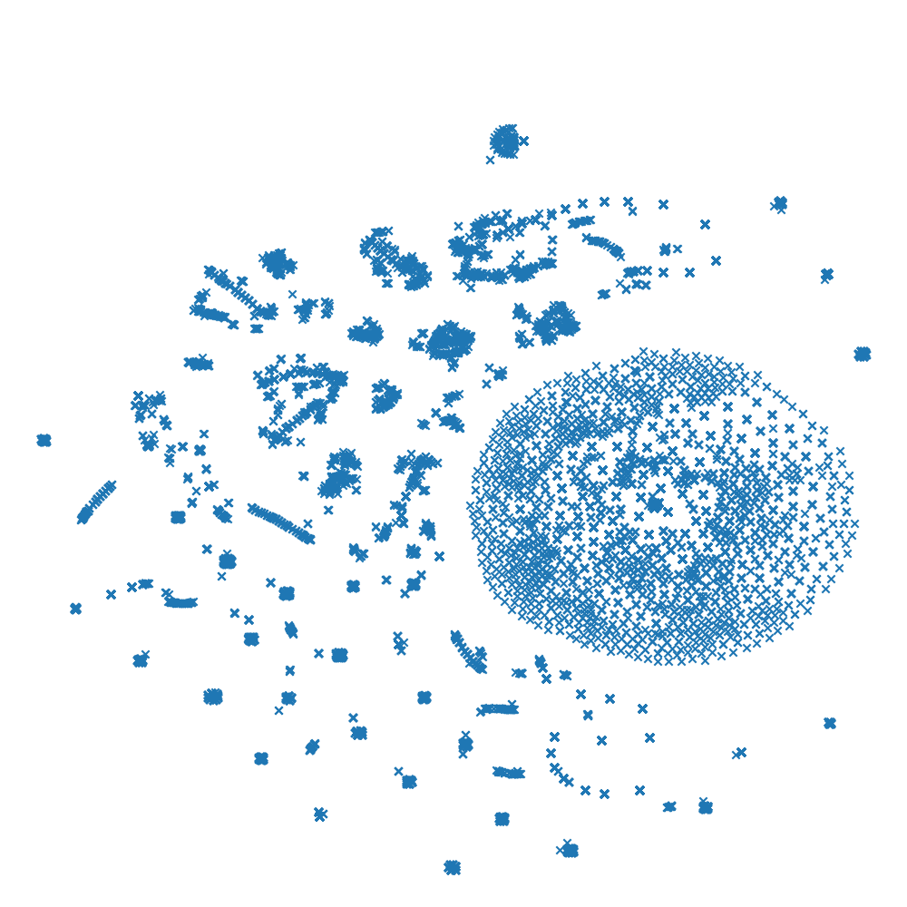
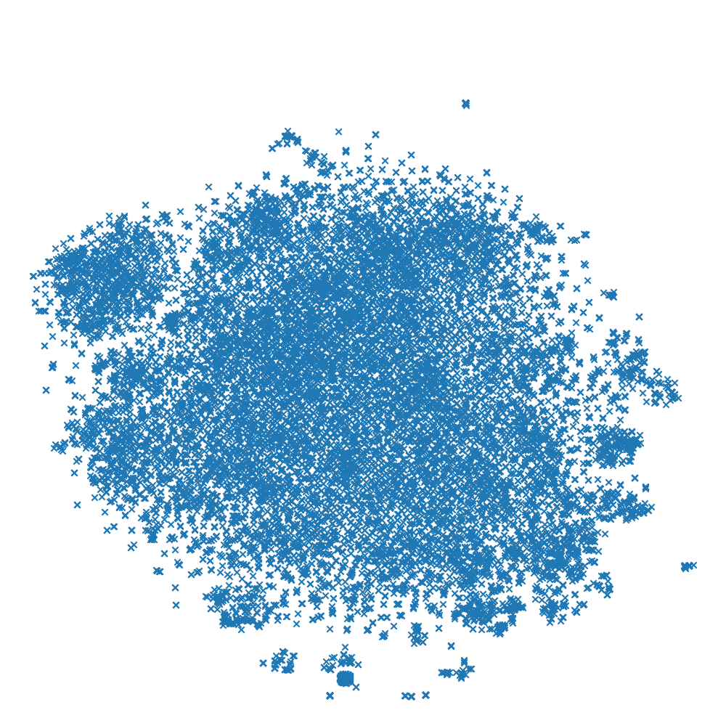
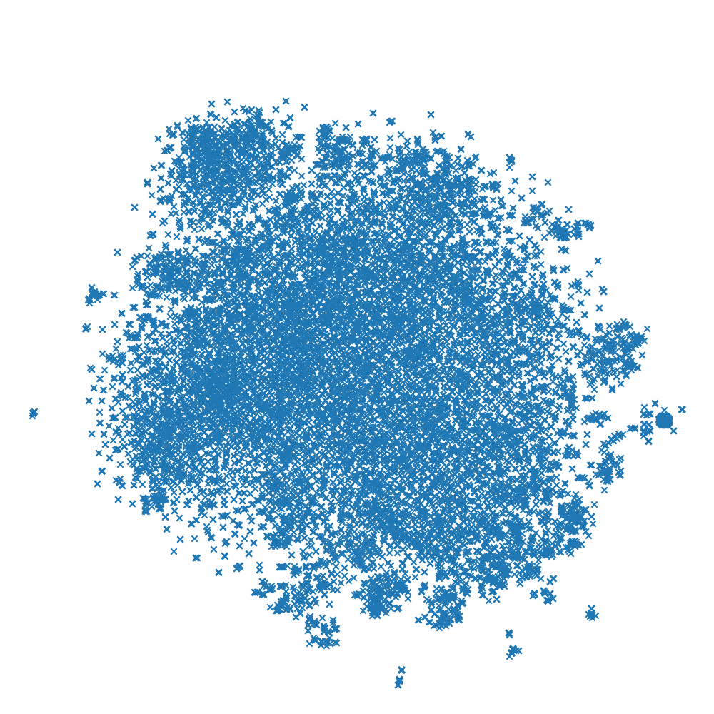
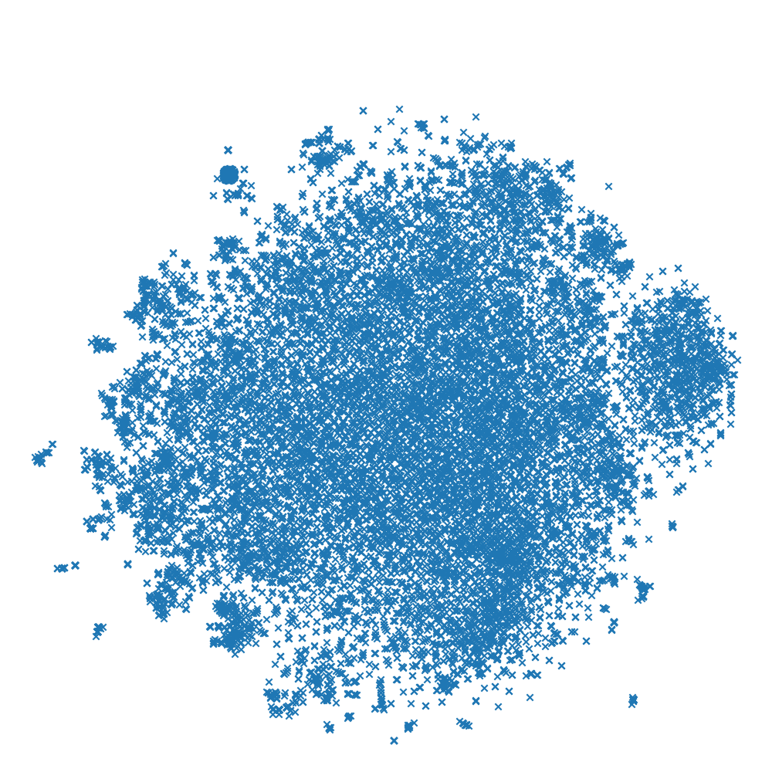
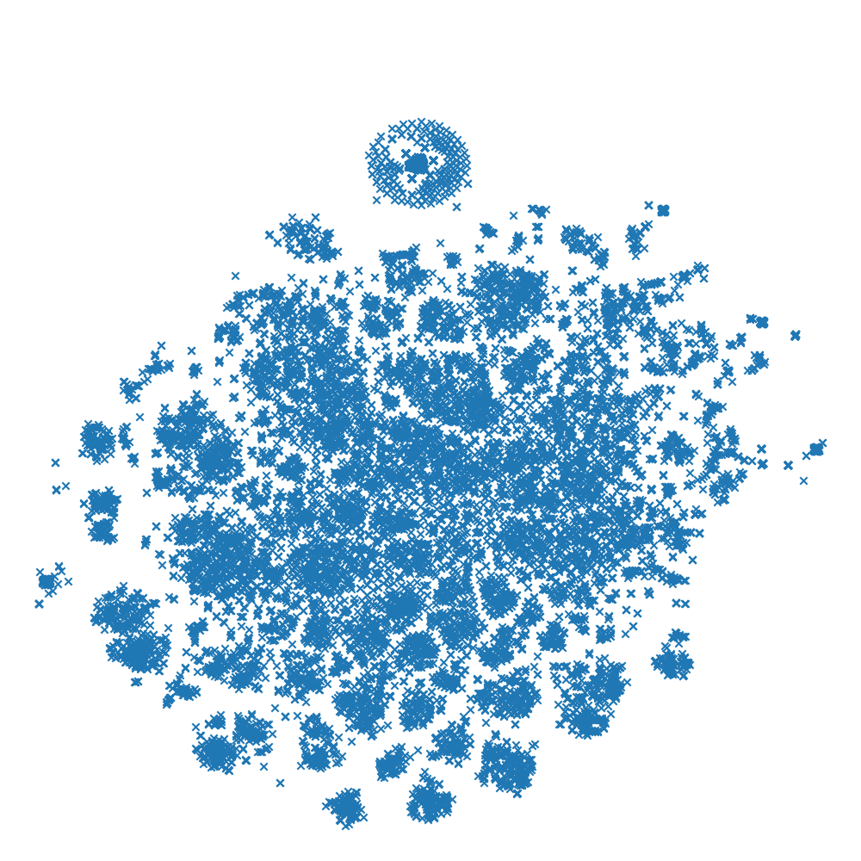
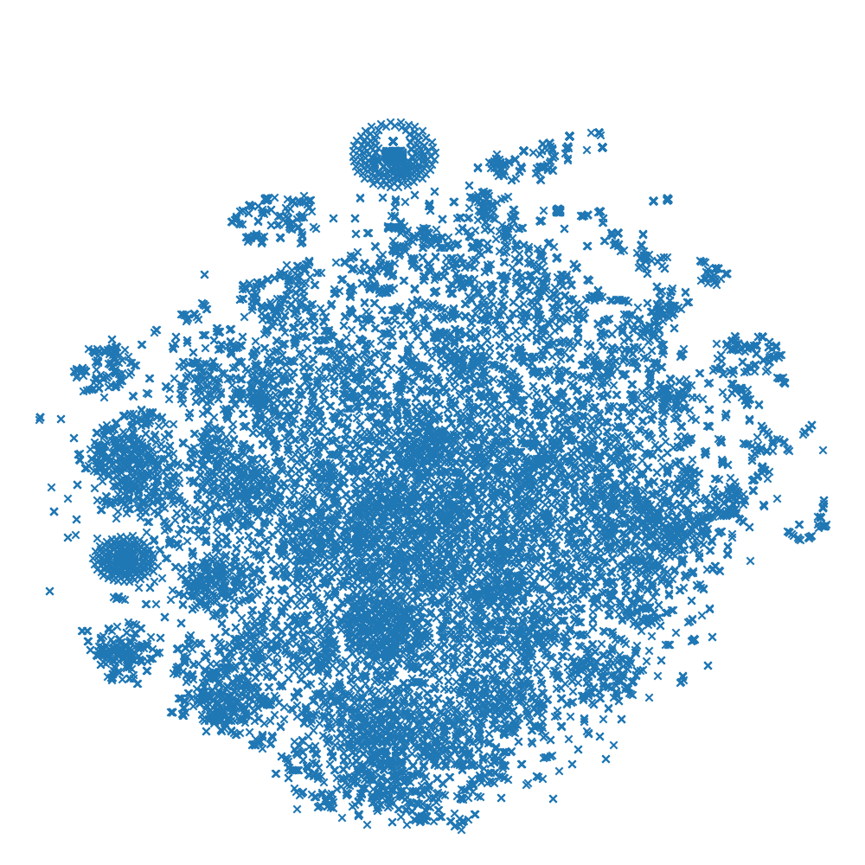
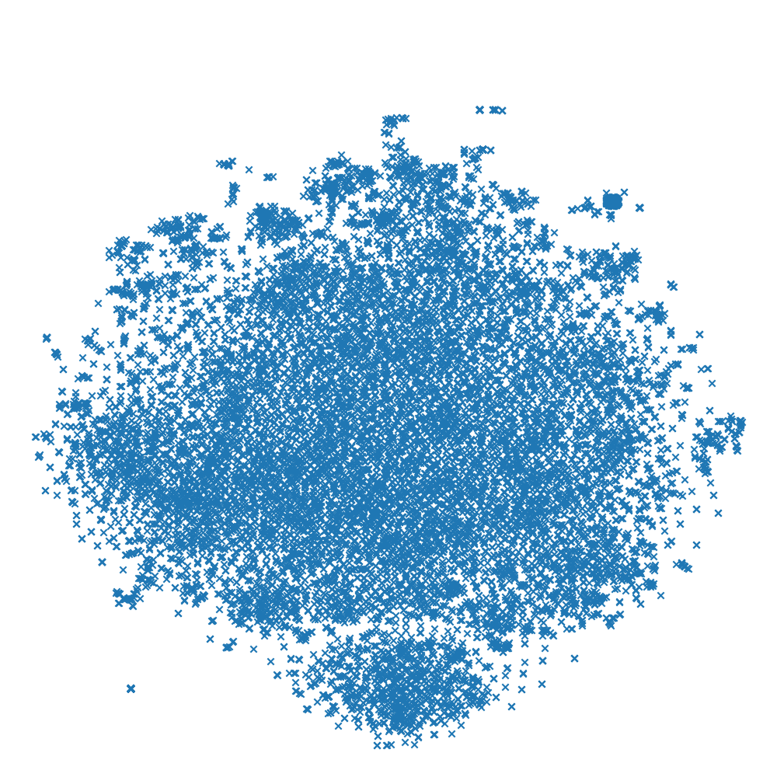
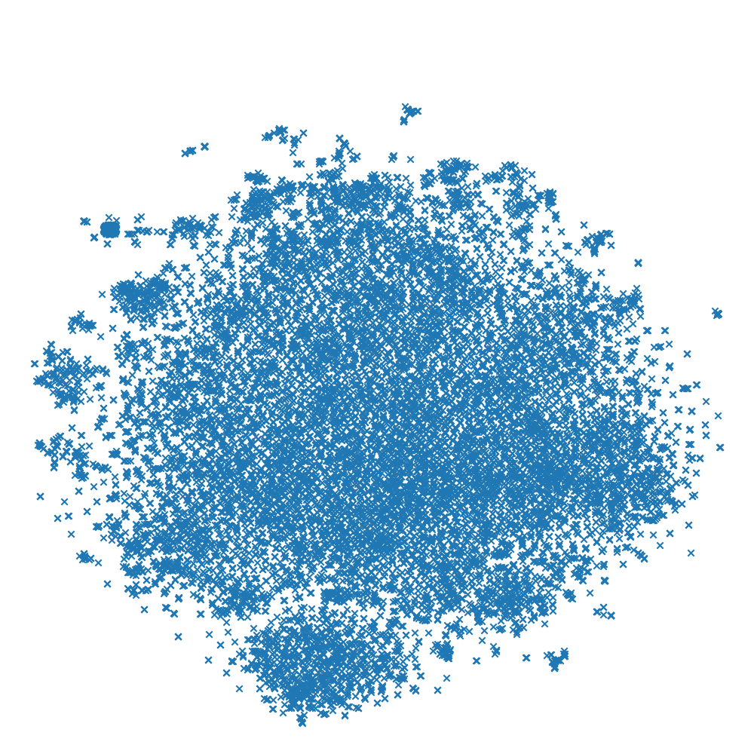
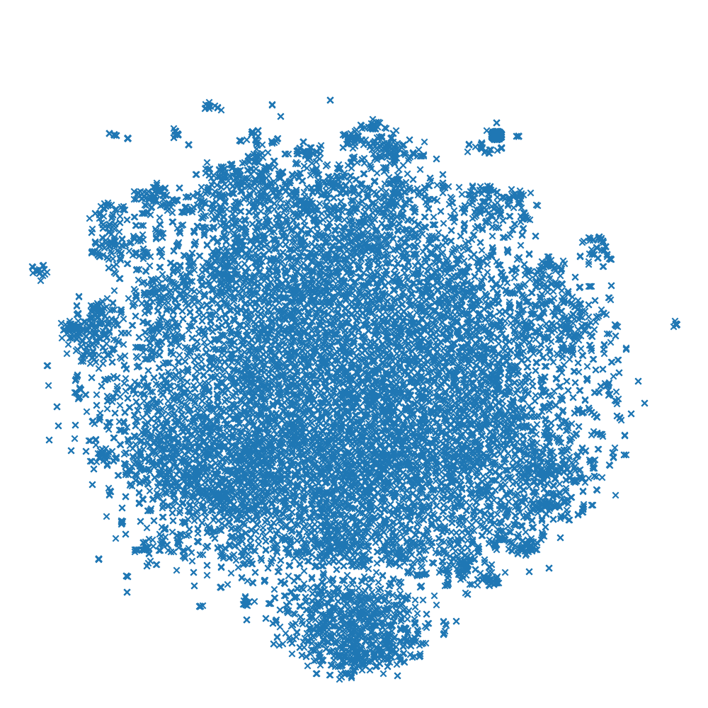
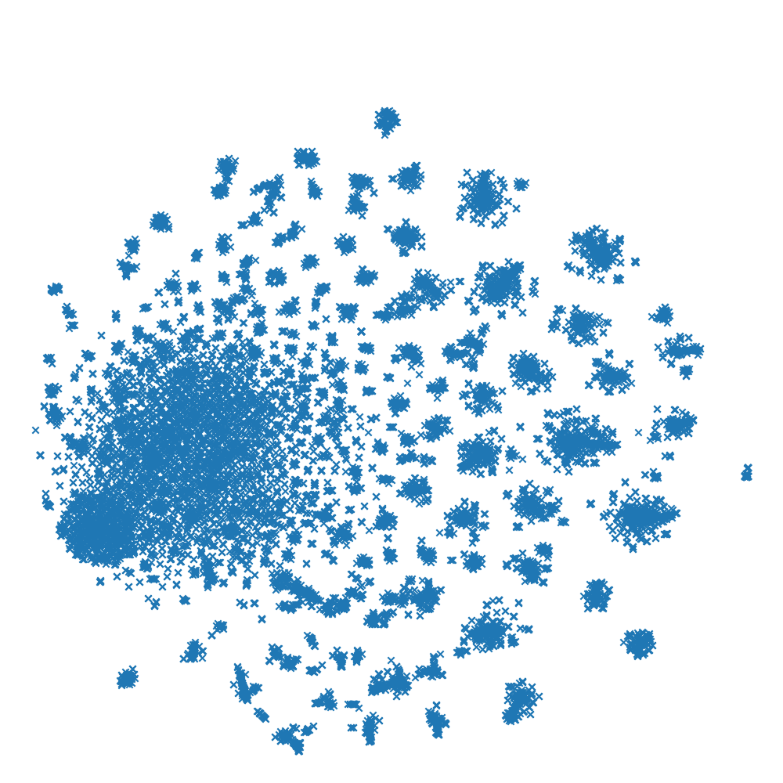
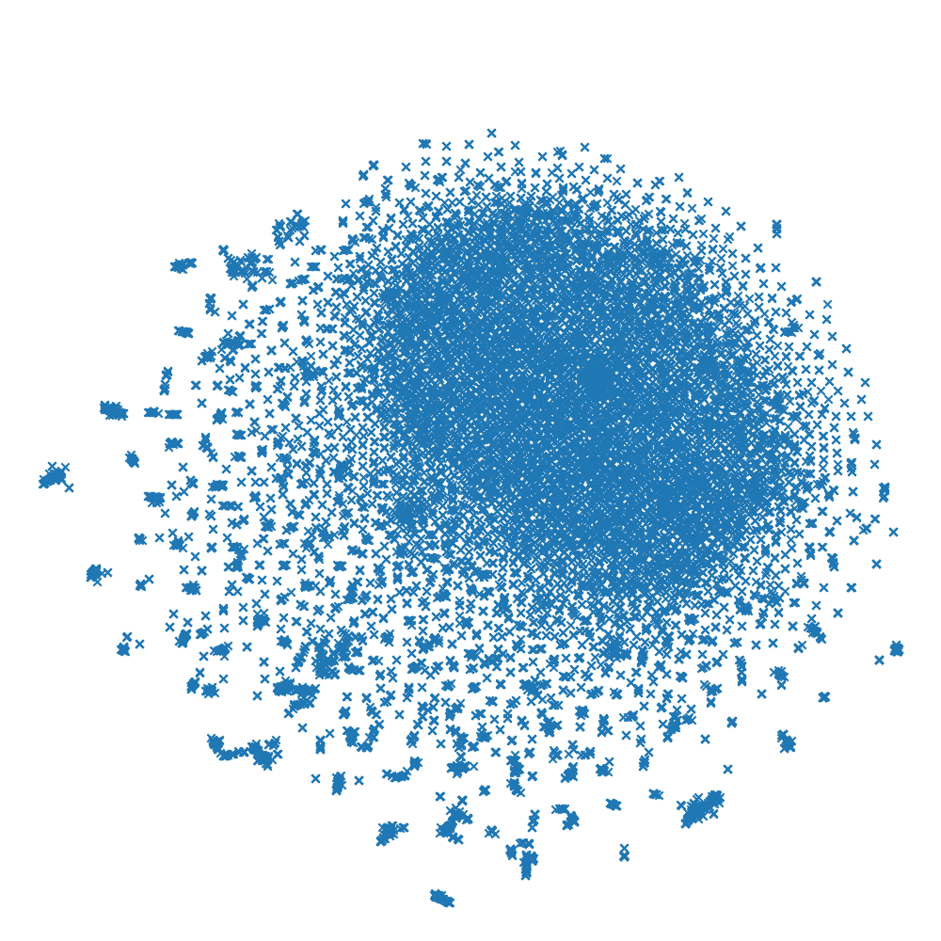
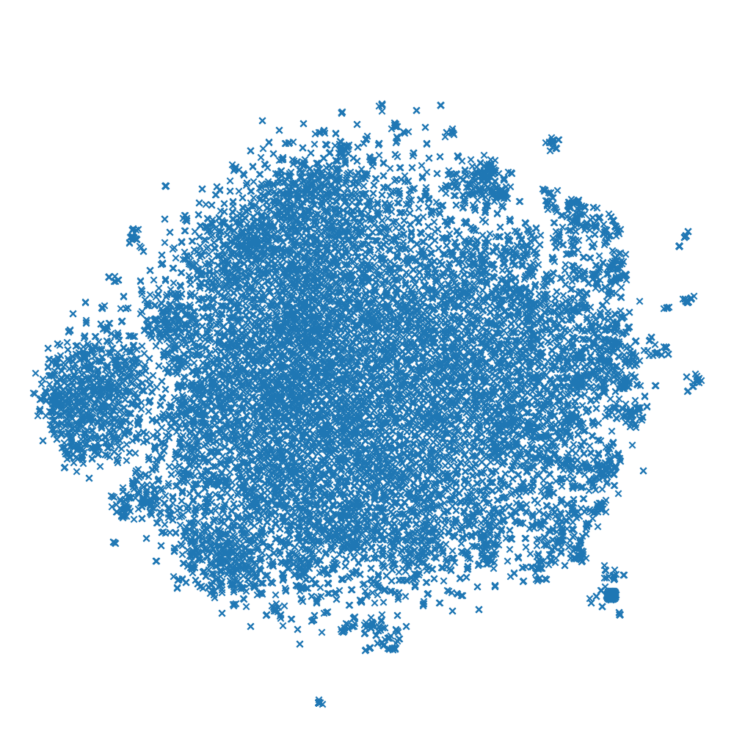
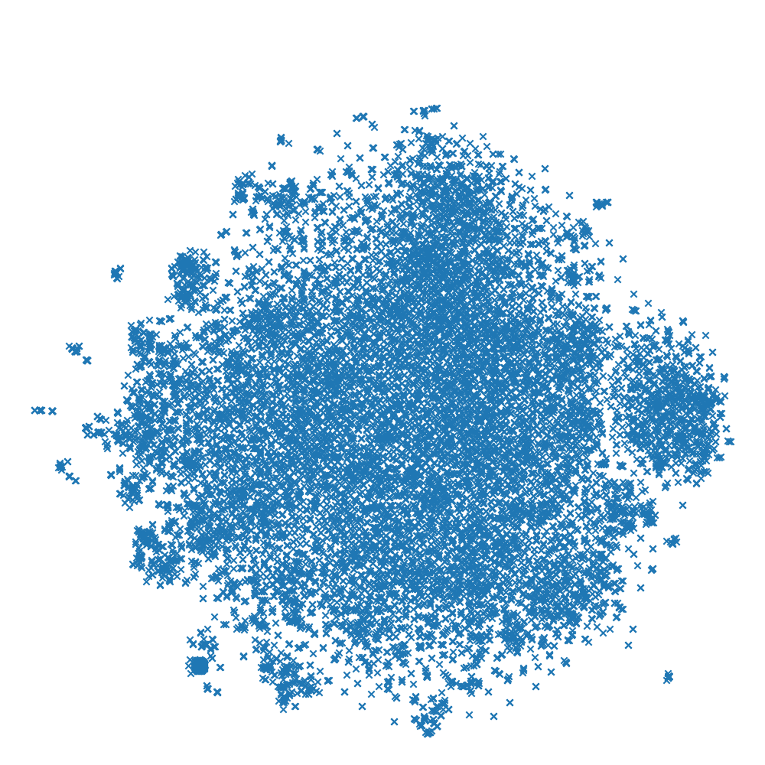
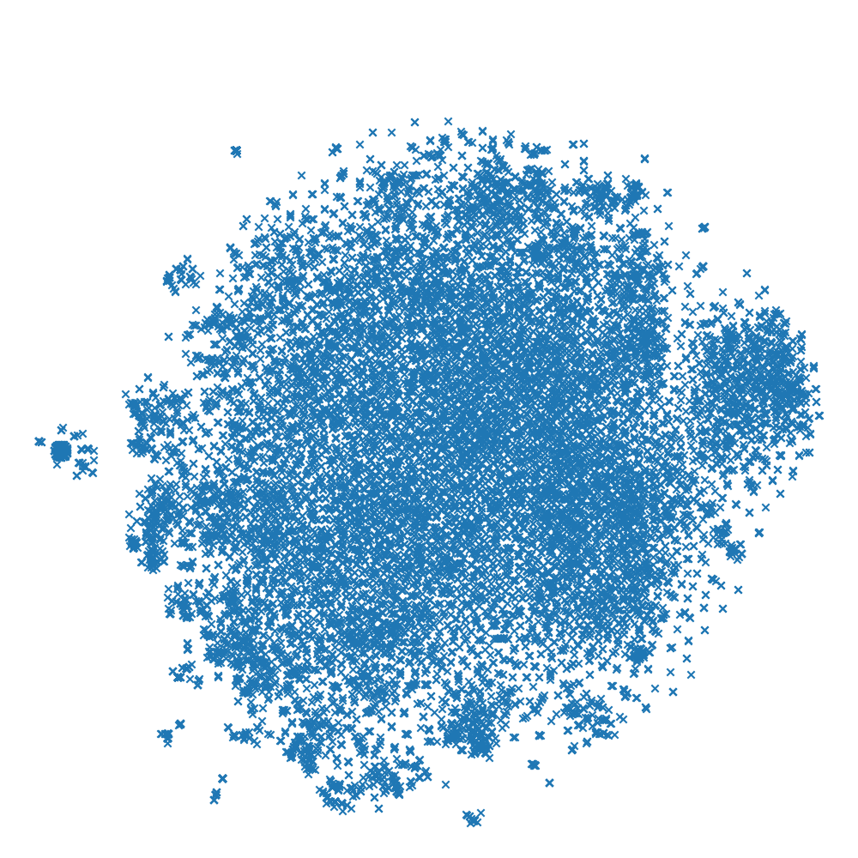
Stylistic Author Attribution Methods for Identifying Parody Trump Tweets
Isaac Pena
Department of Computer Science, Yale University, New Haven, CT
LILY Lab
Introduction
Table 1. Percentages of parody tweets correctly identified vs incorrectly identified, in a feature space including word and pos bigrams
Results
An author with an immediately recognizable style generates immediately recognizable pastiches, or, if the intents of the pastiches are sarcastic, immediately recognizable parodies. Authorship attribution is a natural language processing task that can use both the style and the content of an author's (attributed) body of work to determine if an anonymous document was actually written by that author. An attempt at holistic author attribution needs to take into account non-content features in the case that the content of the training corpus is disjunct or near-disjunct from the content of the anonymous documents that we are trying to attribute to an author. We apply similar methods to parody, in which an author’s style is emulated but content – settings, characters – is changed.
In this experiment the corpus used is the large and continually expanding group of similar texts published by Donald Trump. We also drew from five other pundits who have active Twitter accounts, and chose a handful of Trump parody accounts with various political perspectives, two of which largely tweet about non-political or tangentially political subjects in 'Trump voice’.
 | Trump | Douthat | Chait | Yglesias | Huckabee | Ioffe
@DungeonsDonald | 45.7 | 19.5 | 11.6 | 11.8 | 9.93 | 1.49
@realDonalDrumpf | 30.3 | 24.2 | 12.2 | 9.39 | 17.2 | 6.66
@realDonaldTrFan | 27.4 | 17.9 | 7.95 | 21.2 | 21.3 | 4.25
@realNFLTrump | 34.9 | 19.4 | 11.1 | 15.1 | 17.5 | 1.98
@Writeintrump | 29.7 | 27.2 | 10.5 | 9.24 | 19.5 | 3.93
Two primary problems present in the data for this experiment were clear throughout the process of gathering and compiling the results. The former is the use by multiple authors with distinct stylistic voices of certain Twitter accounts, namely @realDonaldTrump. As late as April 2016, Trump maintained a separate mobile device from that of his staffers and the tweets coming from his account, with his distinctive style, could be identified as his by the fact that they came from an Android. His staffers’ tweets were more promotional in nature and were stylistically quite different from Trump’s own. Since assuming the presidency, however, both Trump and staffers frequently tweet from iPhones, and there is no longer any way to distinguish them. The second is the presence of ‘bad’ parodies in the data – parody accounts who mock Trump but using another voice, like @realDonalDrumpf, which merely lambasts Trump for his most recent gaffe and makes no attempt to stylize themselves with ‘Trump voice’, as well as some of the others in the test set to varying degrees. On no feature space did the classifiers overcome the difficulties that these aspects of the data posed. The best feature spaces found had maximum correctness scores lower than 50 percent; the classifiers’ failures to correctly identify Trump parody as Trump parody leaves us with only the null hypothesis.
gamma=0.05
gamma=0.5
gamma=5
C=100
Materials and Methods
We built a pipeline resembling one that might be used in a traditional support vector machine setup for author attribution. The pipeline cross-validates training data with test data by withholding a validation set from the machine learning algorithm, then proceeds to extract features from the training set and classifies the items in the test set accordingly. t-SNE dimensionality reduction is preceded by either an expansion of the dense feature vector matrix or its decomposition using NLTK’s TruncatedSVD function, and the t-SNE 2-dimensionalization of the feature vectors is plotted. Lastly, the pipeline displays the number of tweets in the test set - organized by actual author - which the classifier guesses correctly alongside the breakdown of incorrect guesses. This makes it easier to visualize which authors are dimensionally “close” to other authors in the particular feature space being examined, and helps to illustrate some of the deeper problems that emerge from the data itself.
C=1000
Conclusion
The primary reason for the failure of this experiment to produce a meaningful answer to the question was the data - any improvements on the experiment must begin there, and will require finding a corpus by an author that uses a single voice that has spun off as many parodies as has Trump. Additionally, our feature spaces contrasted style-sensitive approaches towards parody identification with style-insensitive approaches. Future experimenters should consider looking further afield for features to extract. and may want to consider what idiosyncratic phrastic devices an author uses before considering what means could extract such features from the text.
C=5000
Figure 2. t-SNE visualizations of classifications using various feature spaces. From top to bottom: dependency relations, distance from dependency to head, word and pos. Left: bigrams. Right: trigrams.
Figure 1. Part-of-speech trigram t-SNE visualizations of the test set under different parameters
Acknowledgement
I would like to thank Prof. Dragomir Radev for all his help in making this project succeed.

